Slide 1
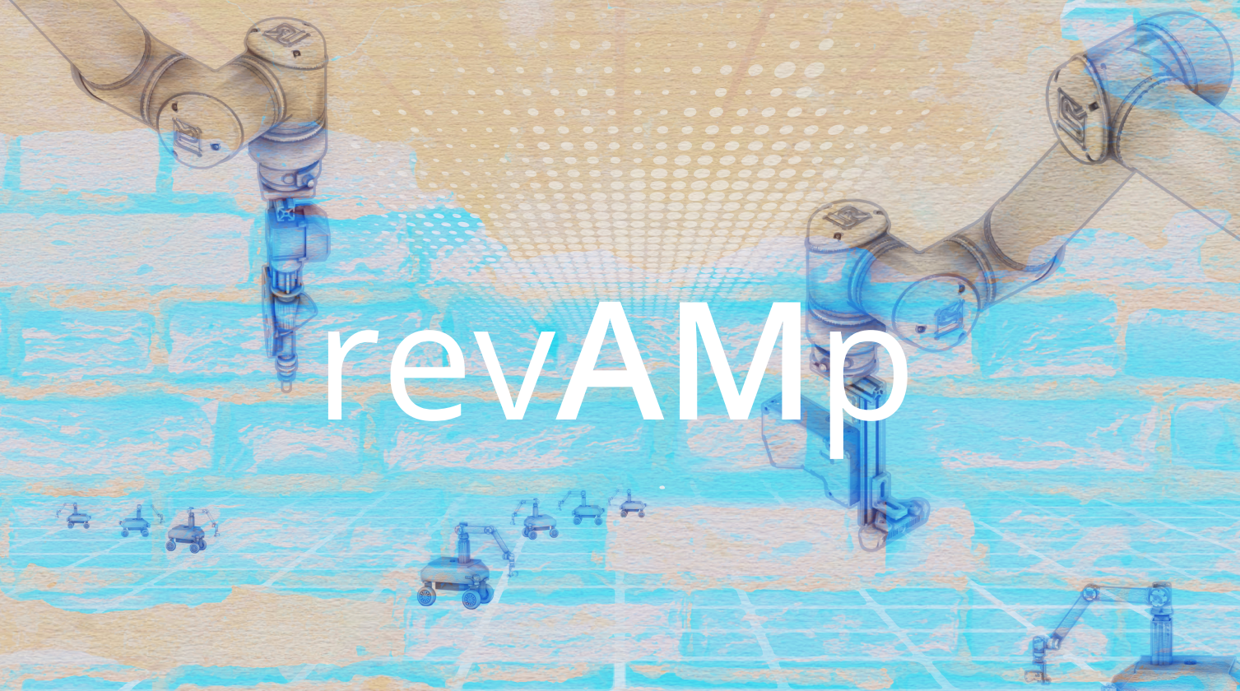

Slide 2


Overview
Session 1
09:00-09:30
Welcome and workshop introduction
Introduction round by students
Work Flow Explanation
Session 2
09:30-11:00
Sensing and data gathering Lecture
Robot approach + Rough and Fine scanning Exploration
Exploration presentations
Session 3
11:30-12:30
Data evaluation Lecture
Point-cloud to Volume Exploration
Session 4
13:30-14:45
Design and Fabrication Lecture
Design studies Exploration
Design presentations
Session 5
14:45-15:30
Fabrication Exploration I
Session 6
16:00-18:00
Fabrication Exploration II
Review and reflections on the result

Slide 3
Introduction
Data evaluation

Slide 4
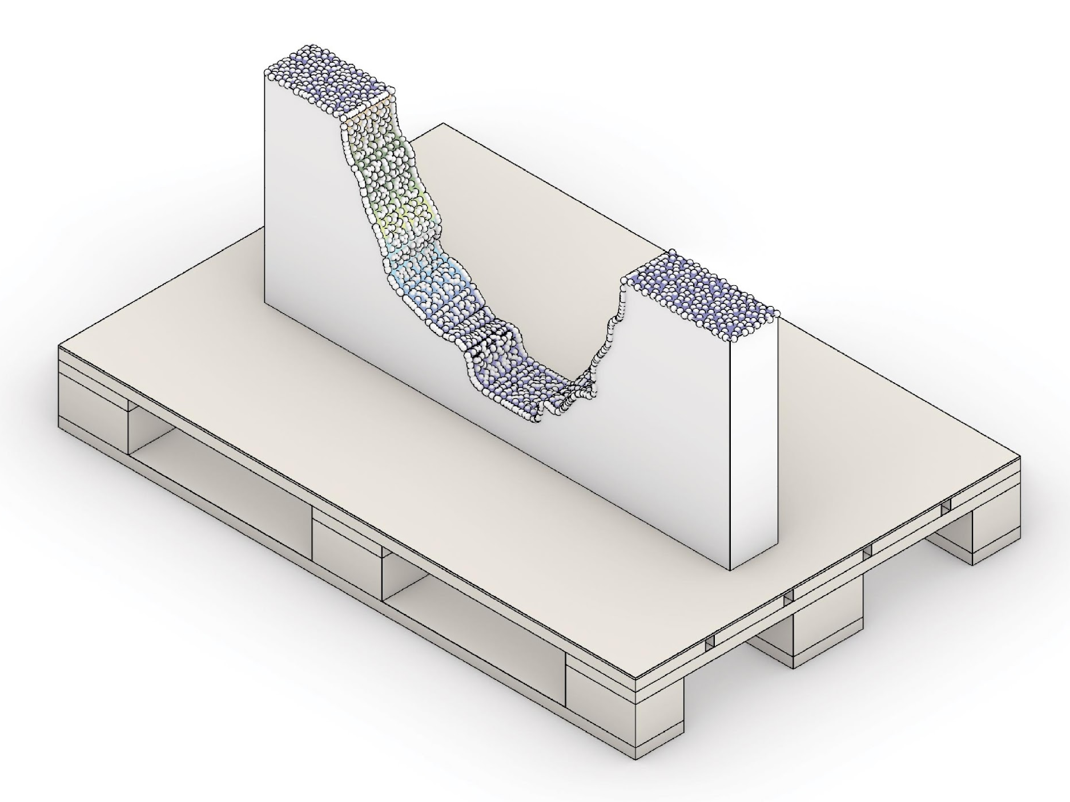
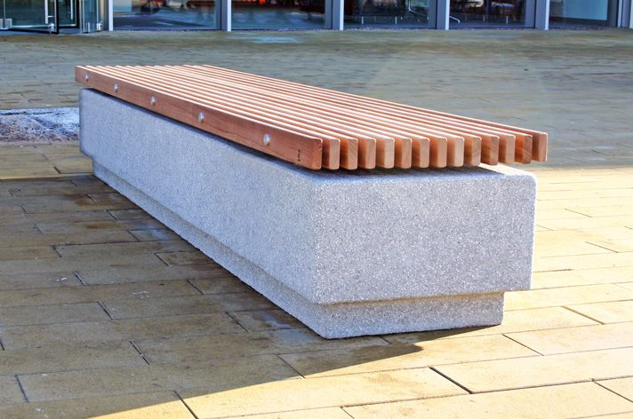
Introduction
Point cloud data to revamp
?
Notes:
We still want to complete the segment to revamp our broken wall.
So, how to get from the point cloud closer to the final object?

Slide 5
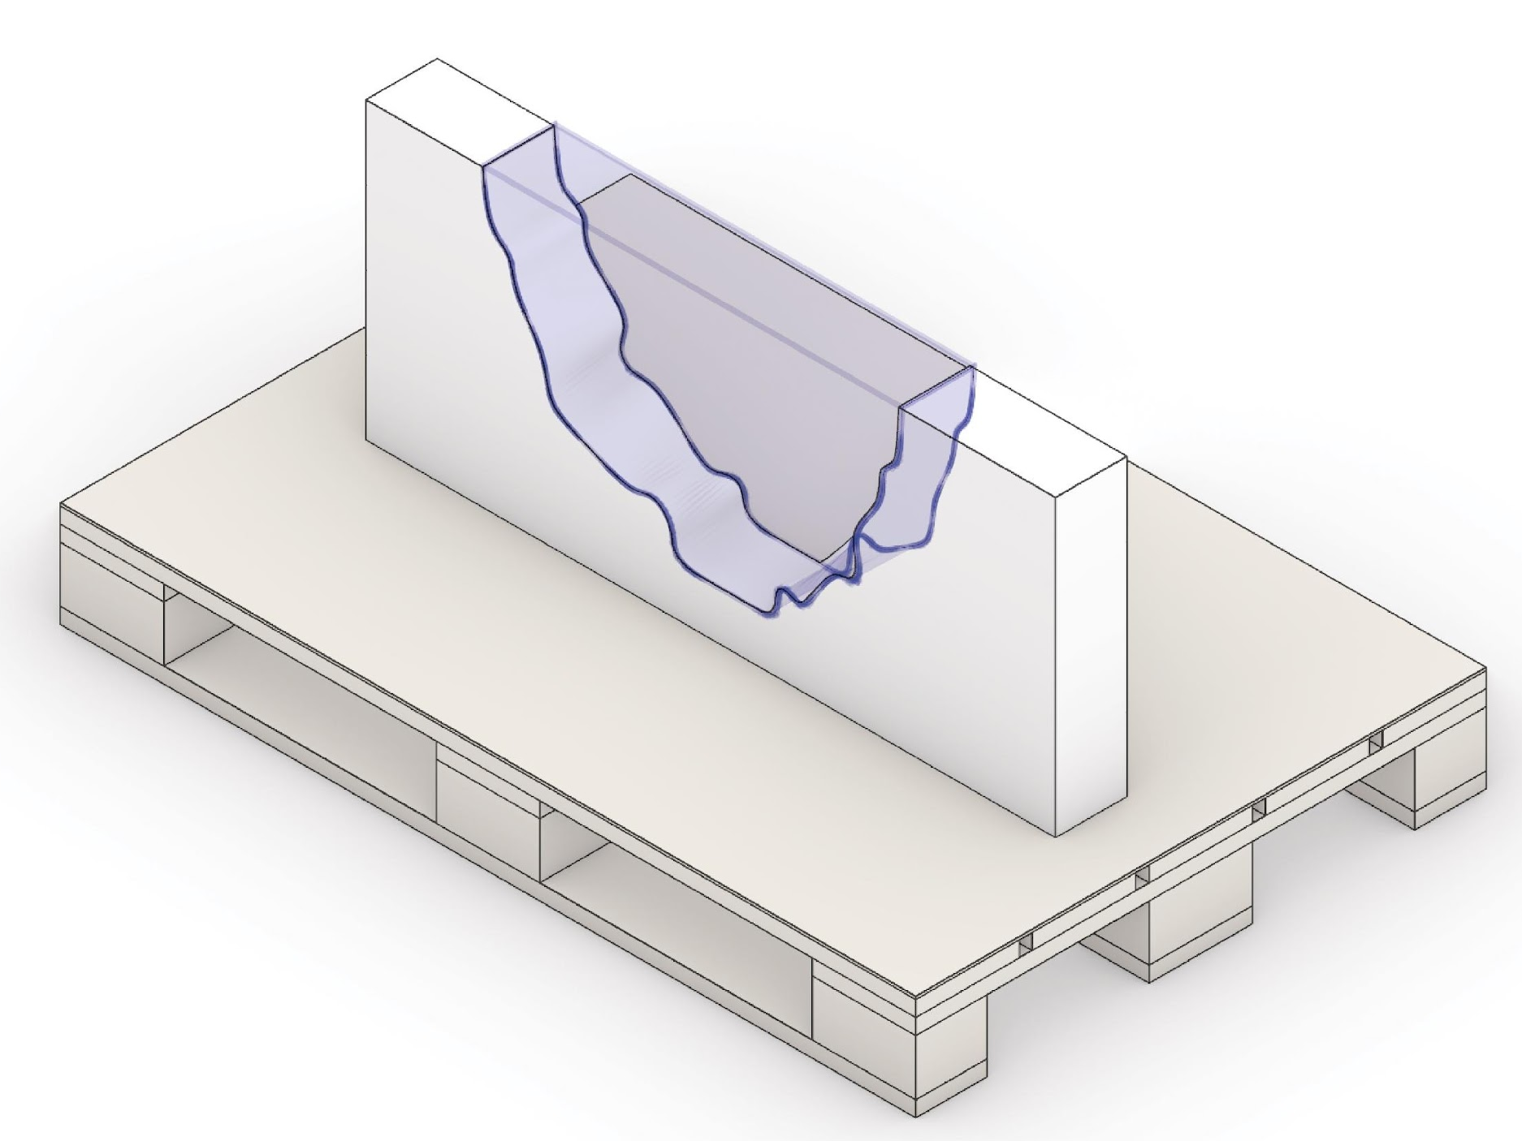
Introduction
Requirement
Notes:
We have to fill in the missing gap.
However, this highly depends on the final geometry we want to build.
Furthermore, we can not extrapolate the data beyond the point cloud.

Slide 6
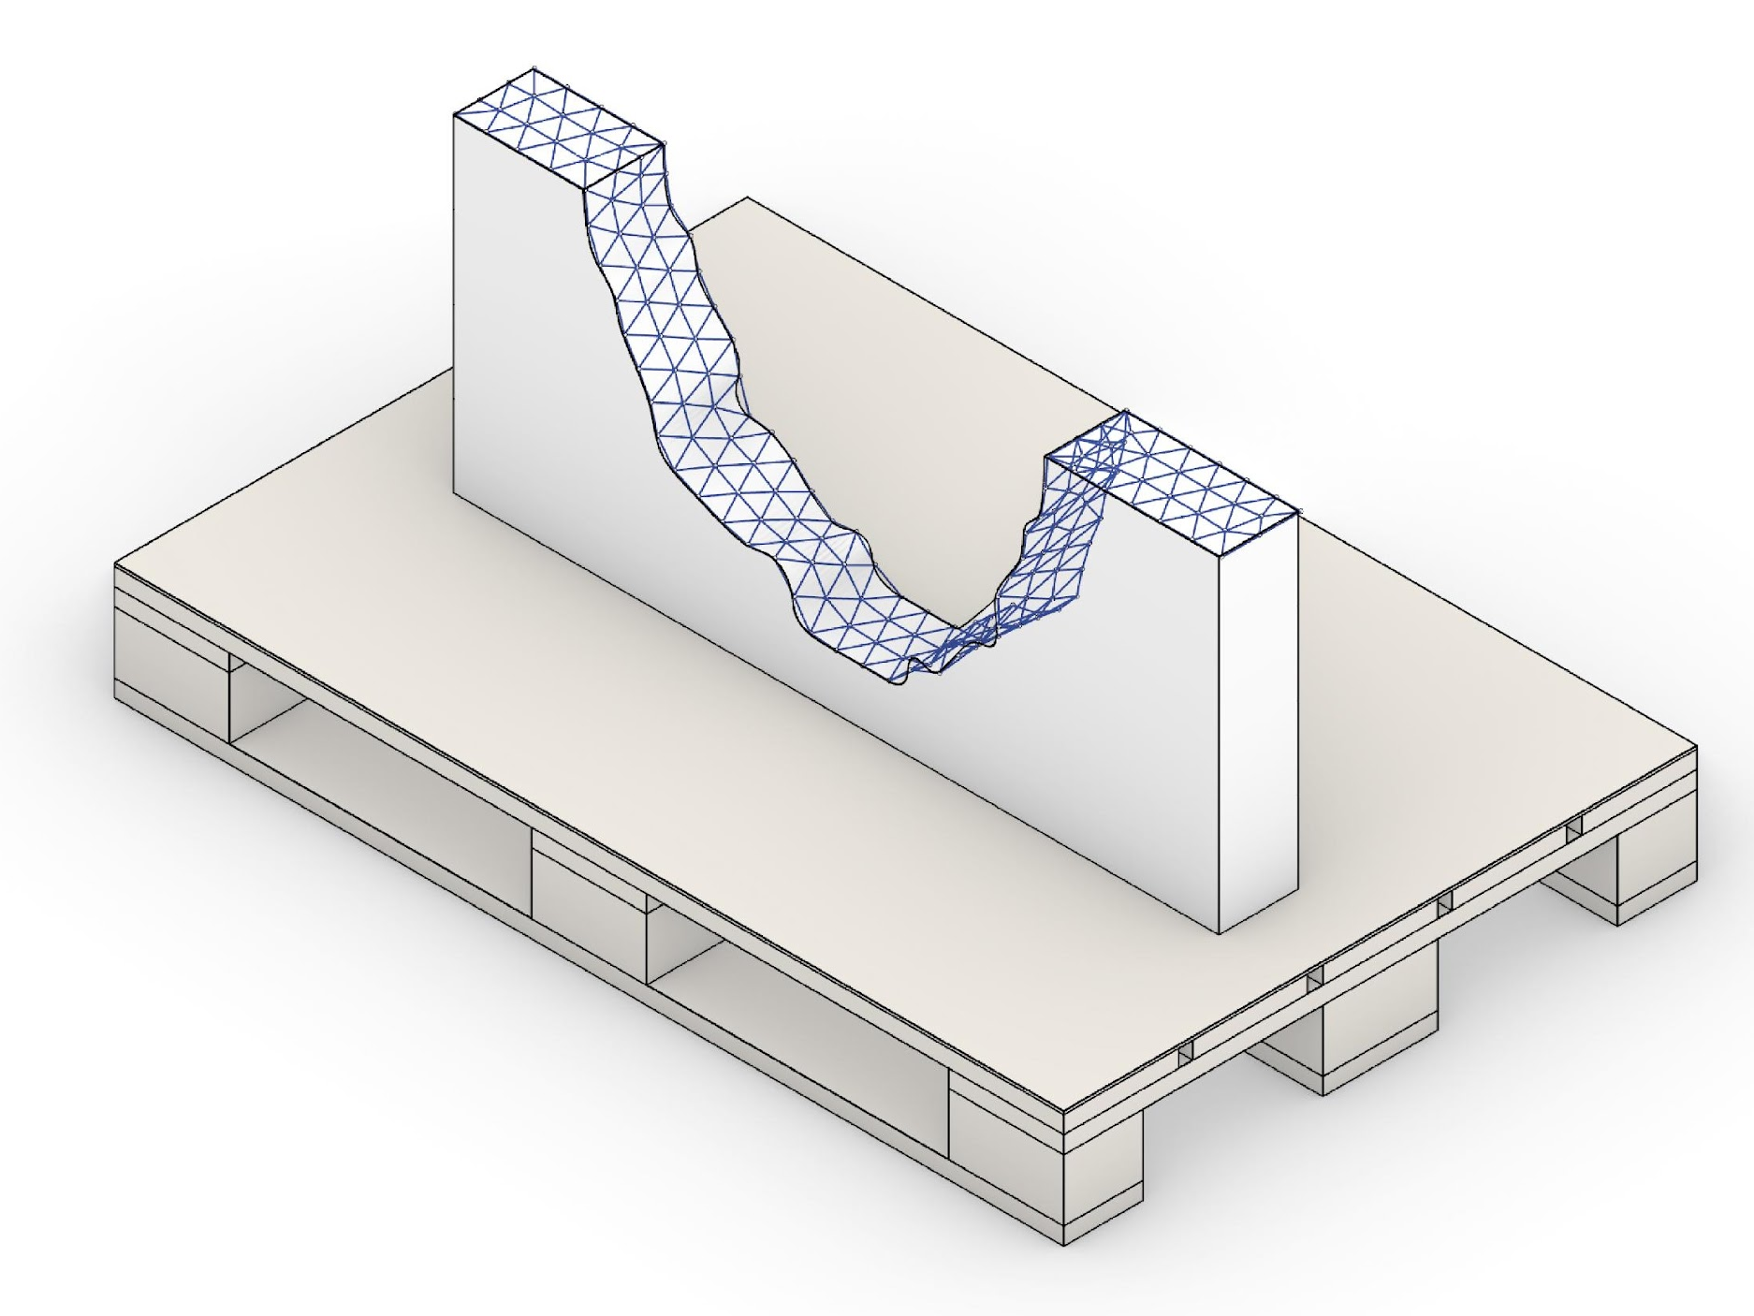
Introduction
Closed surface
Notes:
A closed surface representation will help trim or design objects to be printed on the wall segment.

Slide 7
Workflow
Region of interest
Parameter adjustment
Surface reconstruction
Notes:
We choose a 3 step approach to perform the reconstruction.
At first, we will define a region of interest.
The second step requires the adjustment of the surface parameters, such as density, to reach the required accuracy while avoiding errors.
And finally, we will end up with a reconstructed surface for object design.

Slide 8
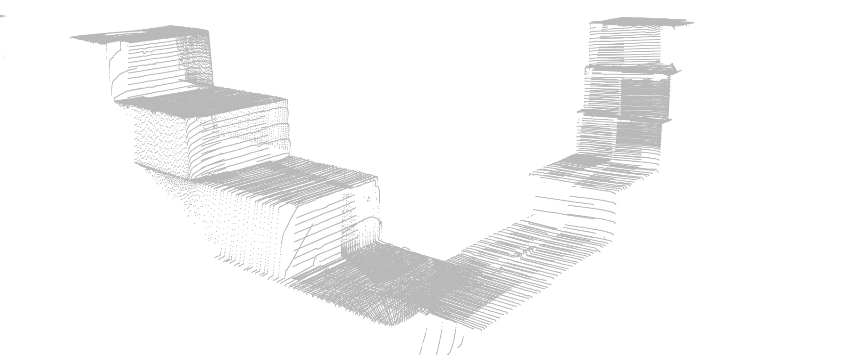
Redion of interest
Raw Point Cloud Data
Notes:
Image of the raw point cloud data.
Defining a region of intereset will help to bring down calculation time.
And increase stability for reconstructed surfaces.
No information about the to be printed part is given.
ROI must be defined manually.

Slide 9
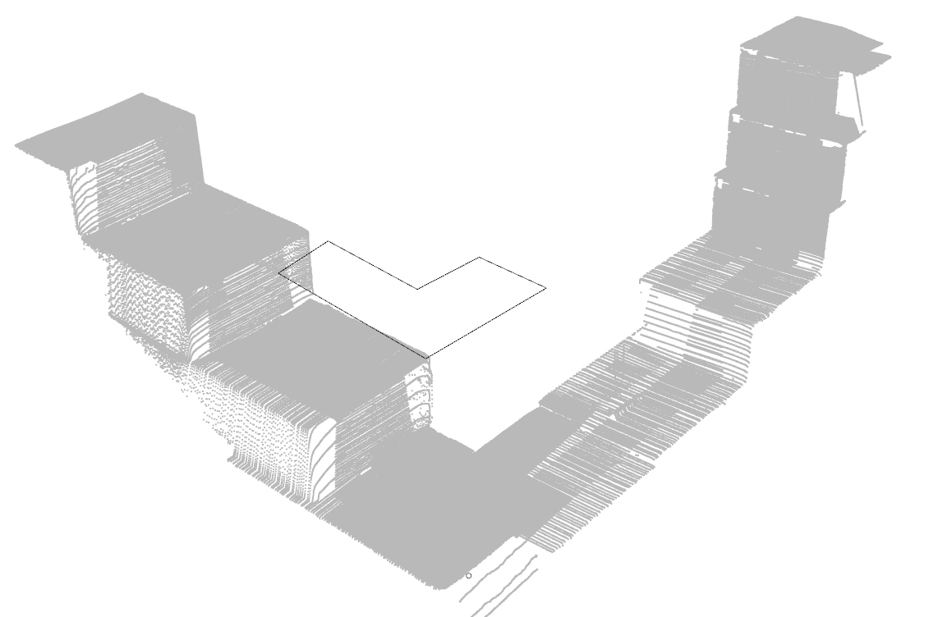
Region of interest
Added 2D ROI above the point cloud
Notes:
Image of the raw point cloud data.
Defining a region of intereset will help to bring down calculation time.
And increase stability for reconstructed surfaces.
No information about the to be printed part is given.
ROI must be defined manually.

Slide 10
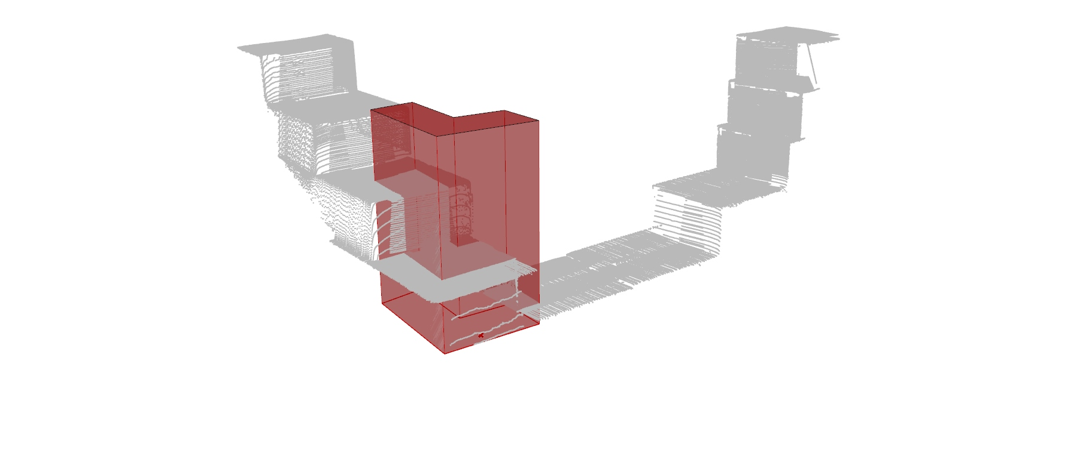
Region of interest
Extrusion towards the point cloud
Notes:
We will extend the defined region towards the point cloud.
In our case simple z-direction is sufficient.
More complex methods can be thought of.
However, this approximation is usually enough for 2.5D printing operations due to the small laser-scanning distance.

Slide 11
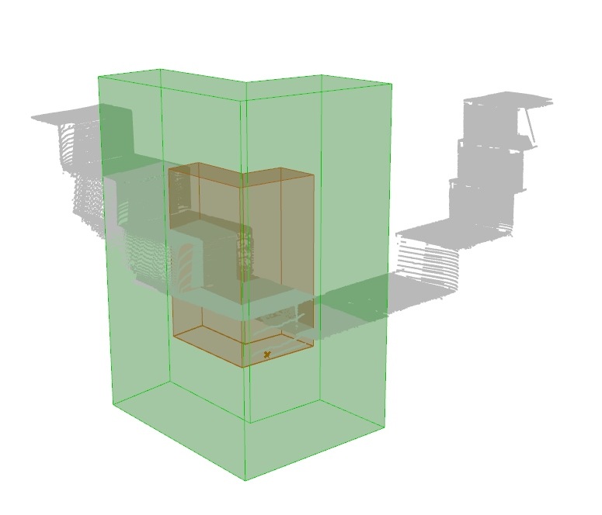
Region of interest
Equal scaling
Notes:
We are upscaling the boundary volume to add some design flexibility.

Slide 12
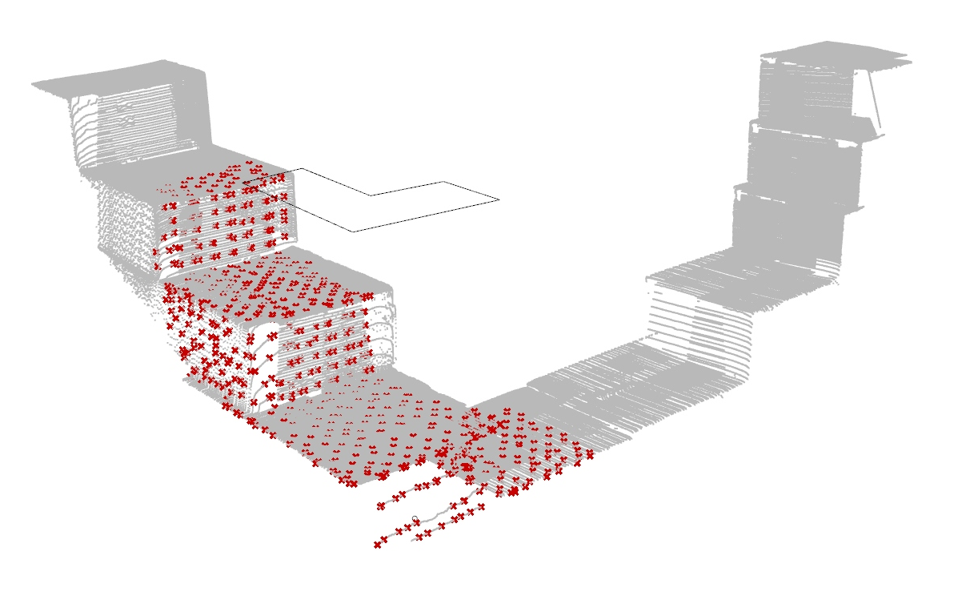
Parameter adjustment
Subsampling by 10
Notes:
Points within the ROI.
A high subsampling is used to avoid measurement errors and closed surface generation.
Subsampling factor ~10, this is possible due to the dense point clouds provided by the laser scanner.

Slide 13
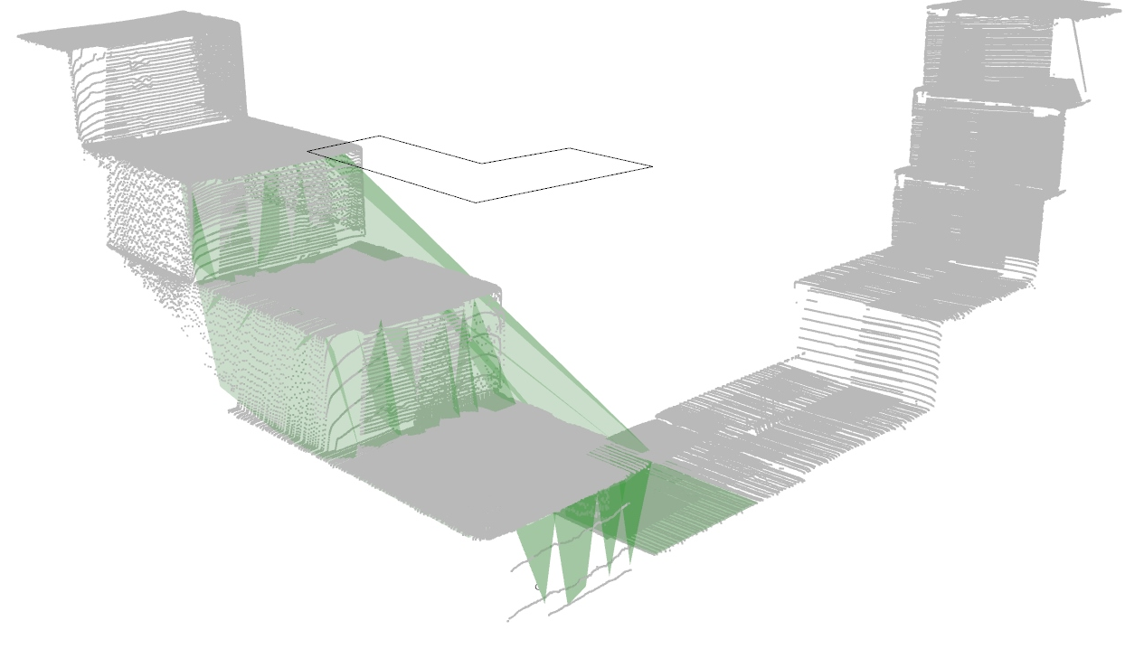
Parameter adjustment
Utilization of Delauny-Triangulation Face-Count 200, Accuracy 10mm
Notes:
Points within the ROI.
A high subsampling is used to avoid measurement errors and closed surface generation.
Subsampling factor ~10, this is possible due to the dense point clouds provided by the laser scanner.

Slide 14
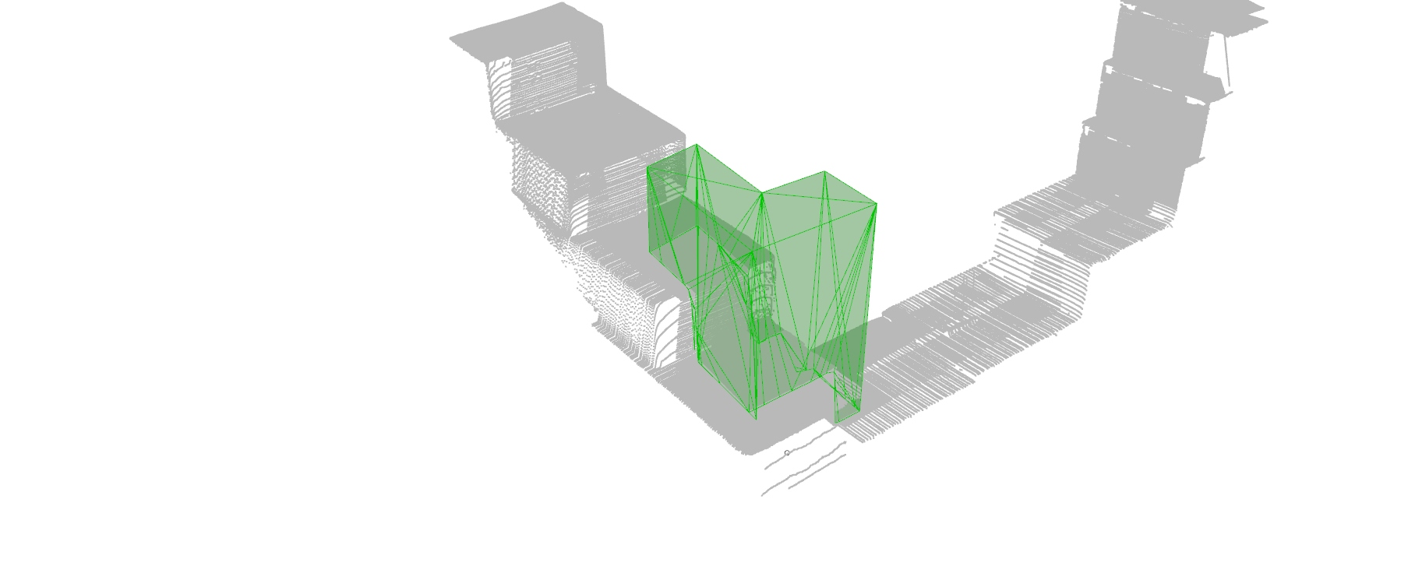
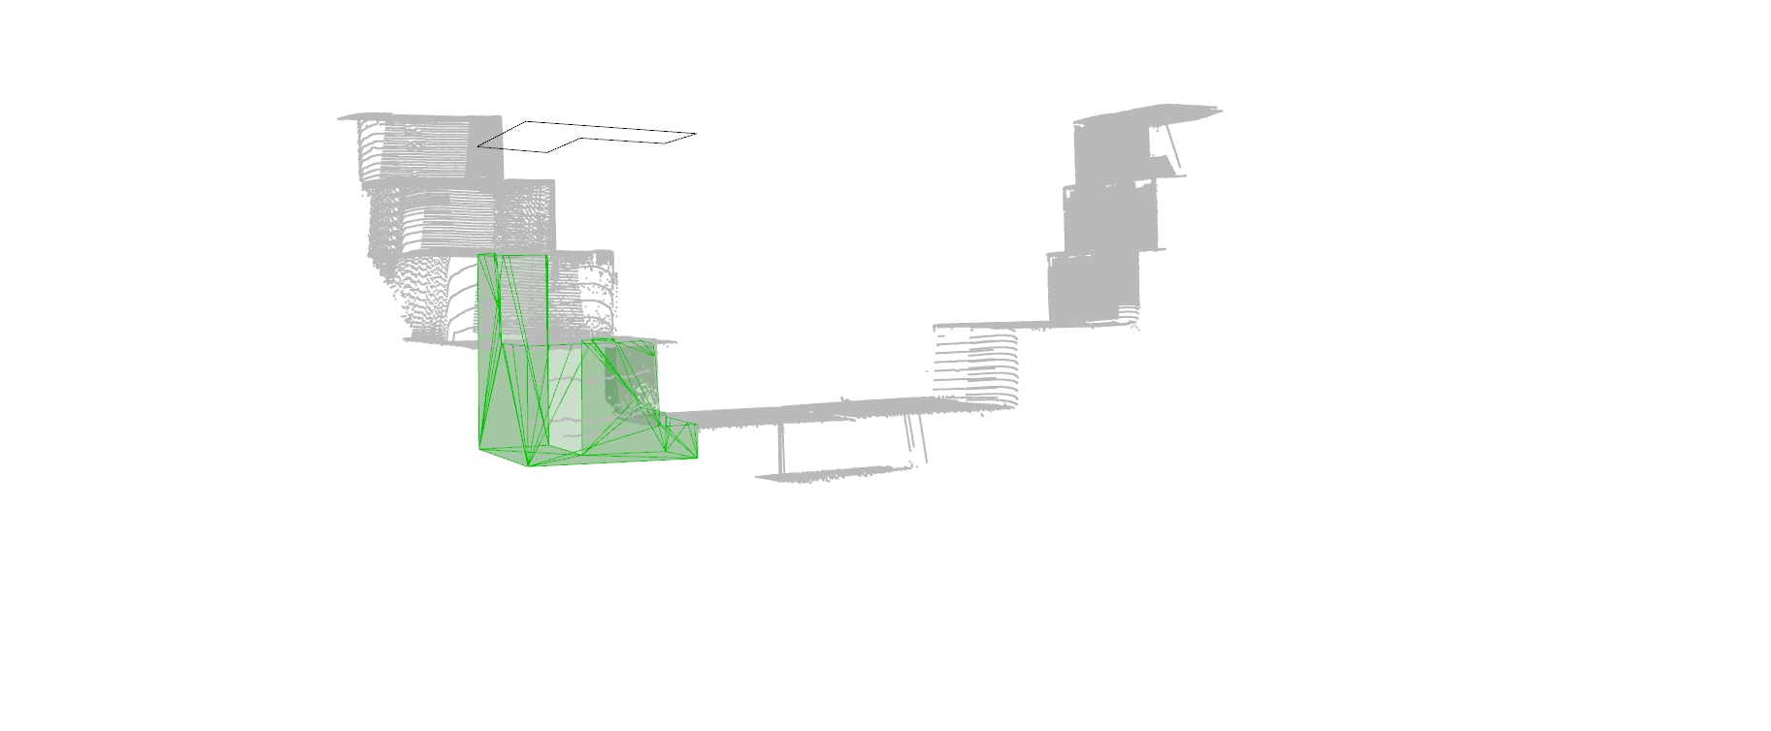
Parameter adjustment
Top or bottom
Notes:
Points within the ROI.
A high subsampling is used to avoid measurement errors and closed surface generation.
Subsampling factor ~10, this is possible due to the dense point clouds provided by the laser scanner.

Slide 15
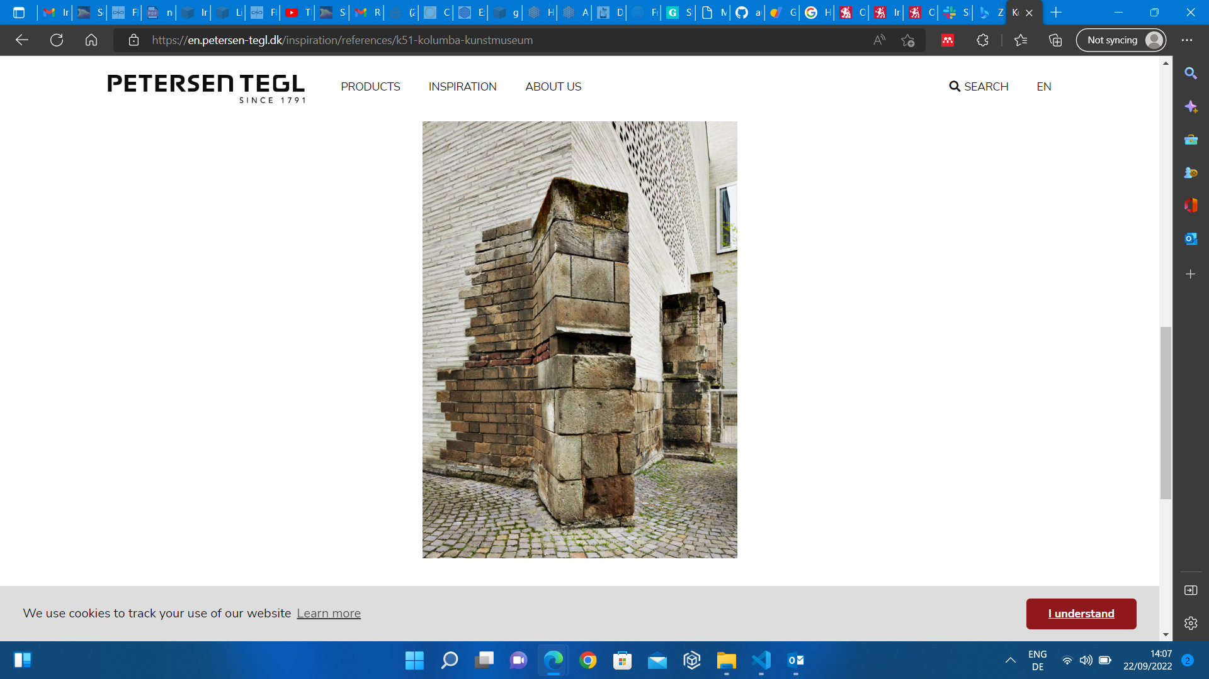
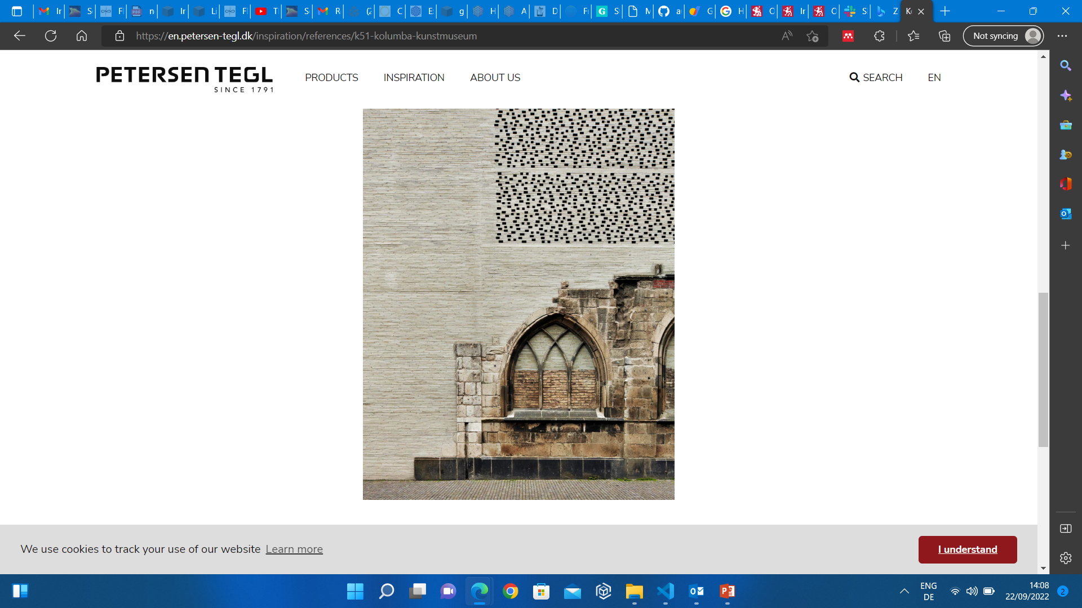
Inspiration
KOLUMBA MUSEUM by Atelier Peter Zumthor & Partner, 2007.
Notes:
https://www.apartmenttherapy.com/lego-artist-fix-buildings-266595

Slide 16
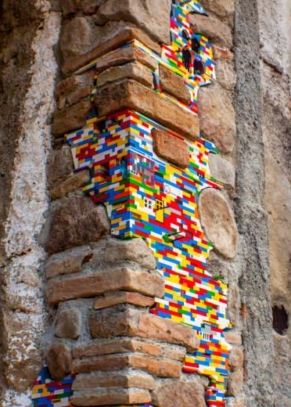
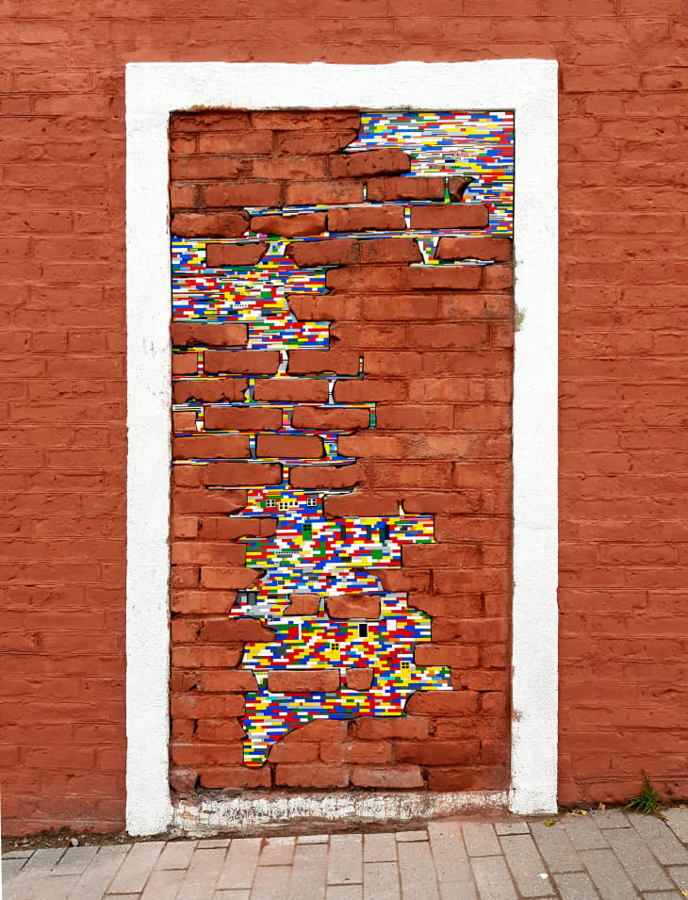
Inspiration
LEGO repairs by street artist Jan Vormann, 2007.
Notes:
https://www.amusingplanet.com/2010/03/jan-vormann-repairs-crumbling-monuments.html

Slide 17
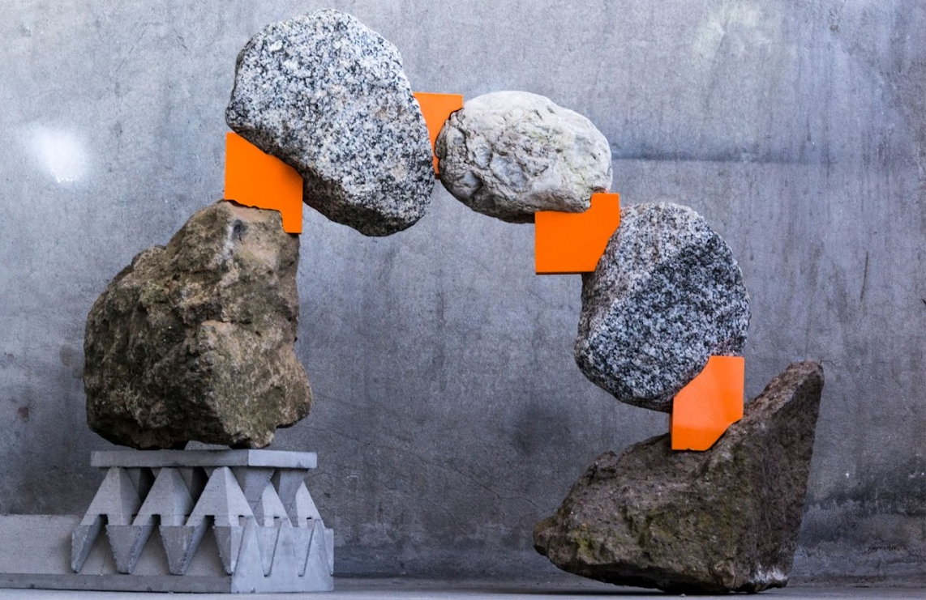
Inspiration
Digital Rubble by Bastian Wibranek and Prof. Oliver Tessmann.
Notes:
https://www.dg.architektur.tu-darmstadt.de/forschung_ddu/digitale_prozessketten_ddu/additive_manufacturing/digital_rubble/index.en.jsp

Slide 18
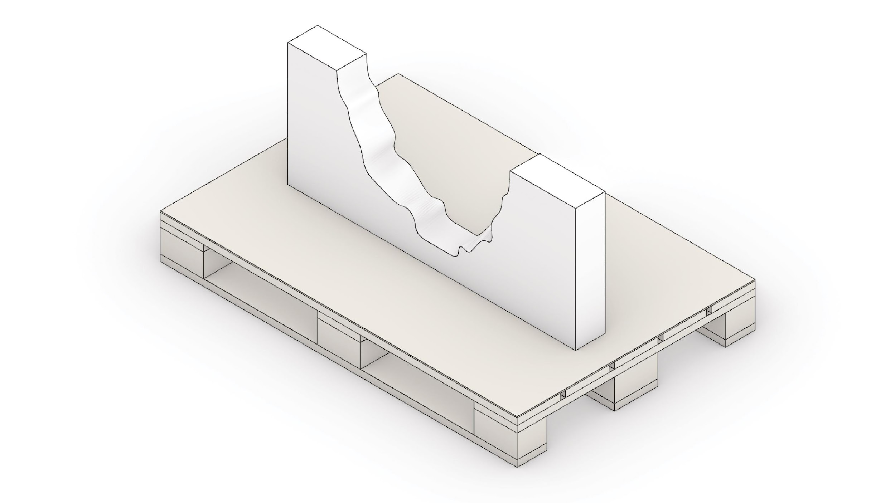
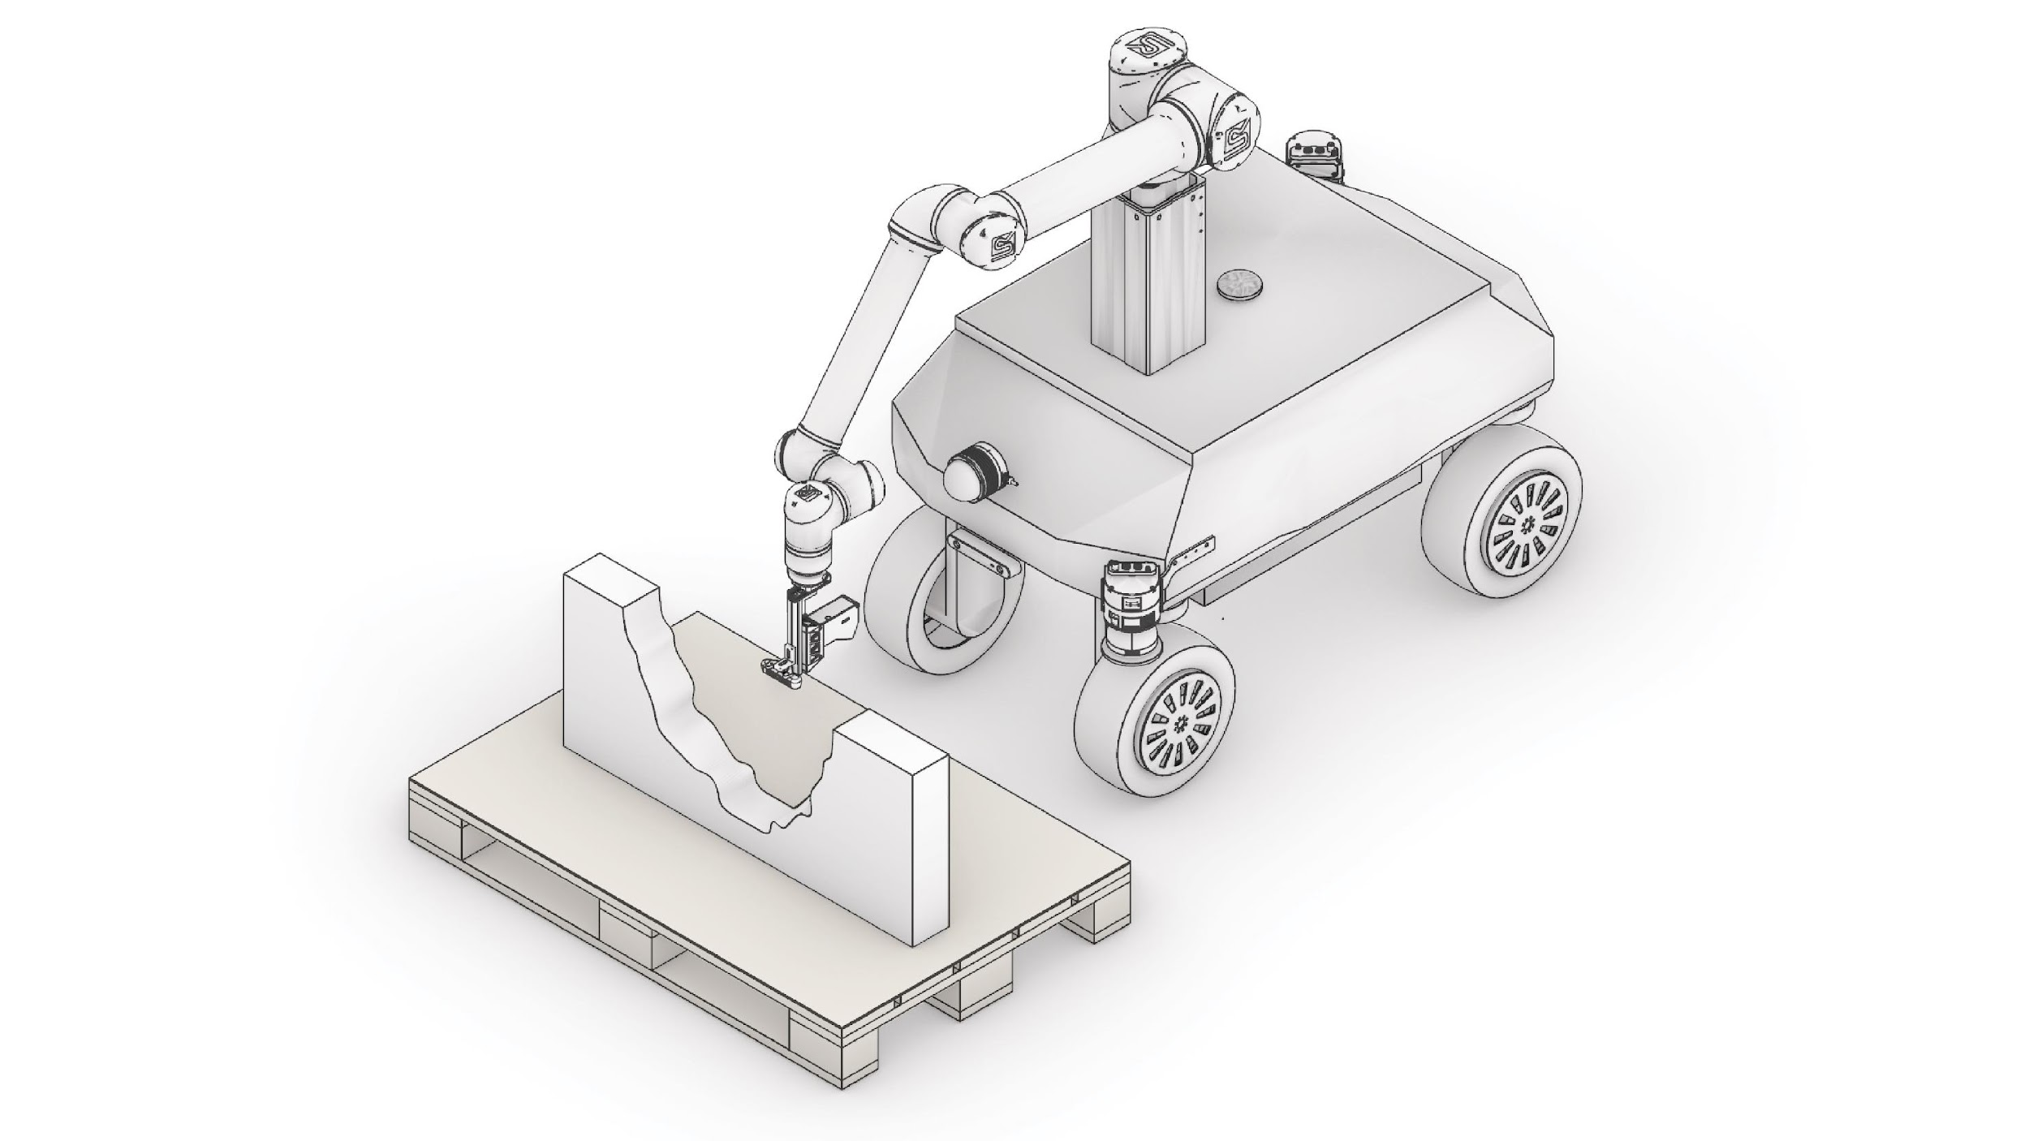
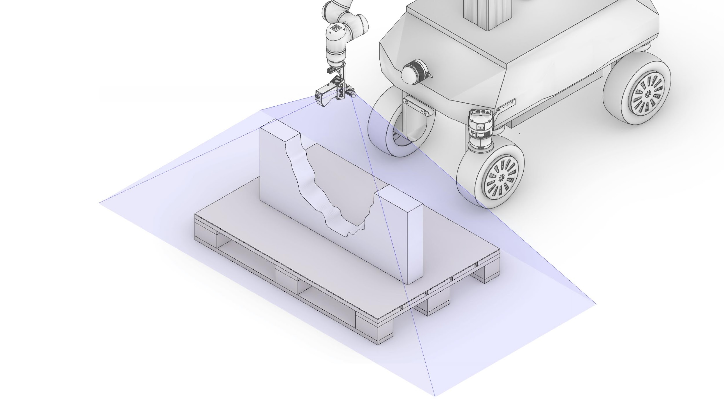
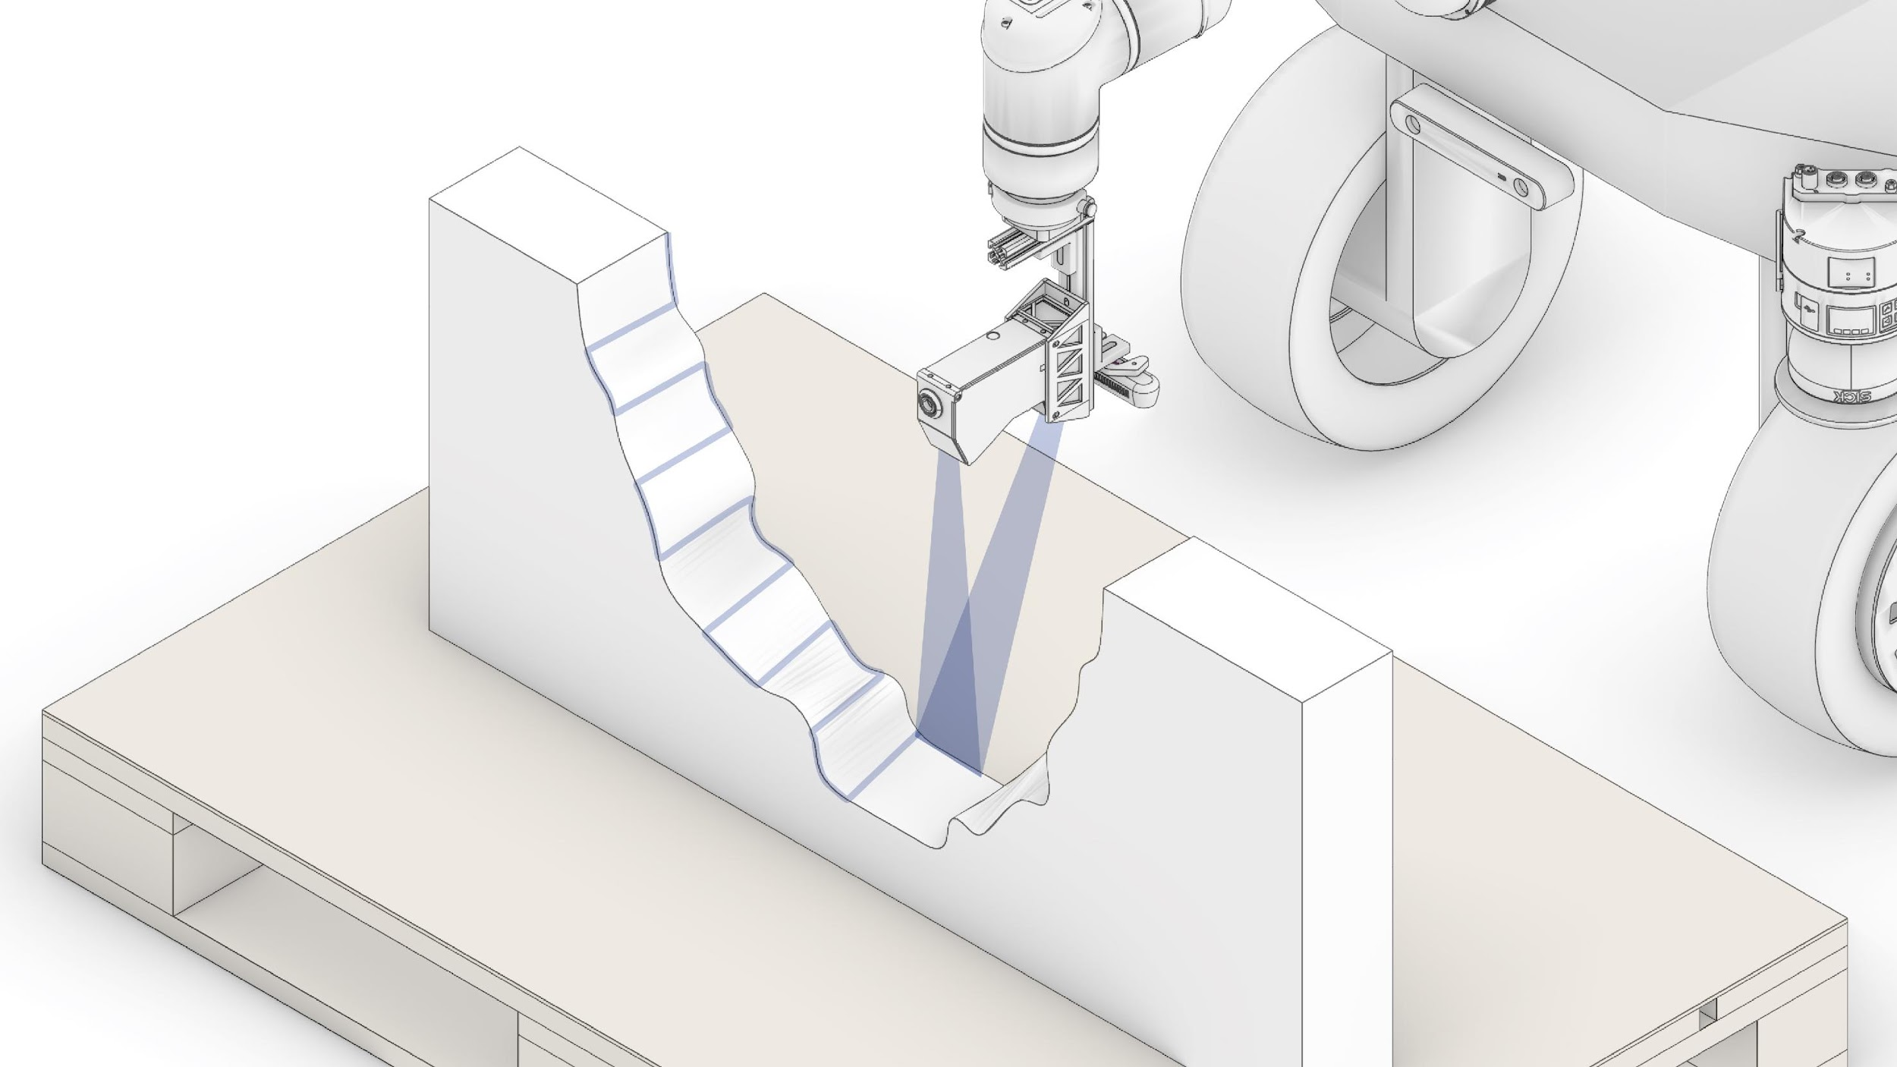
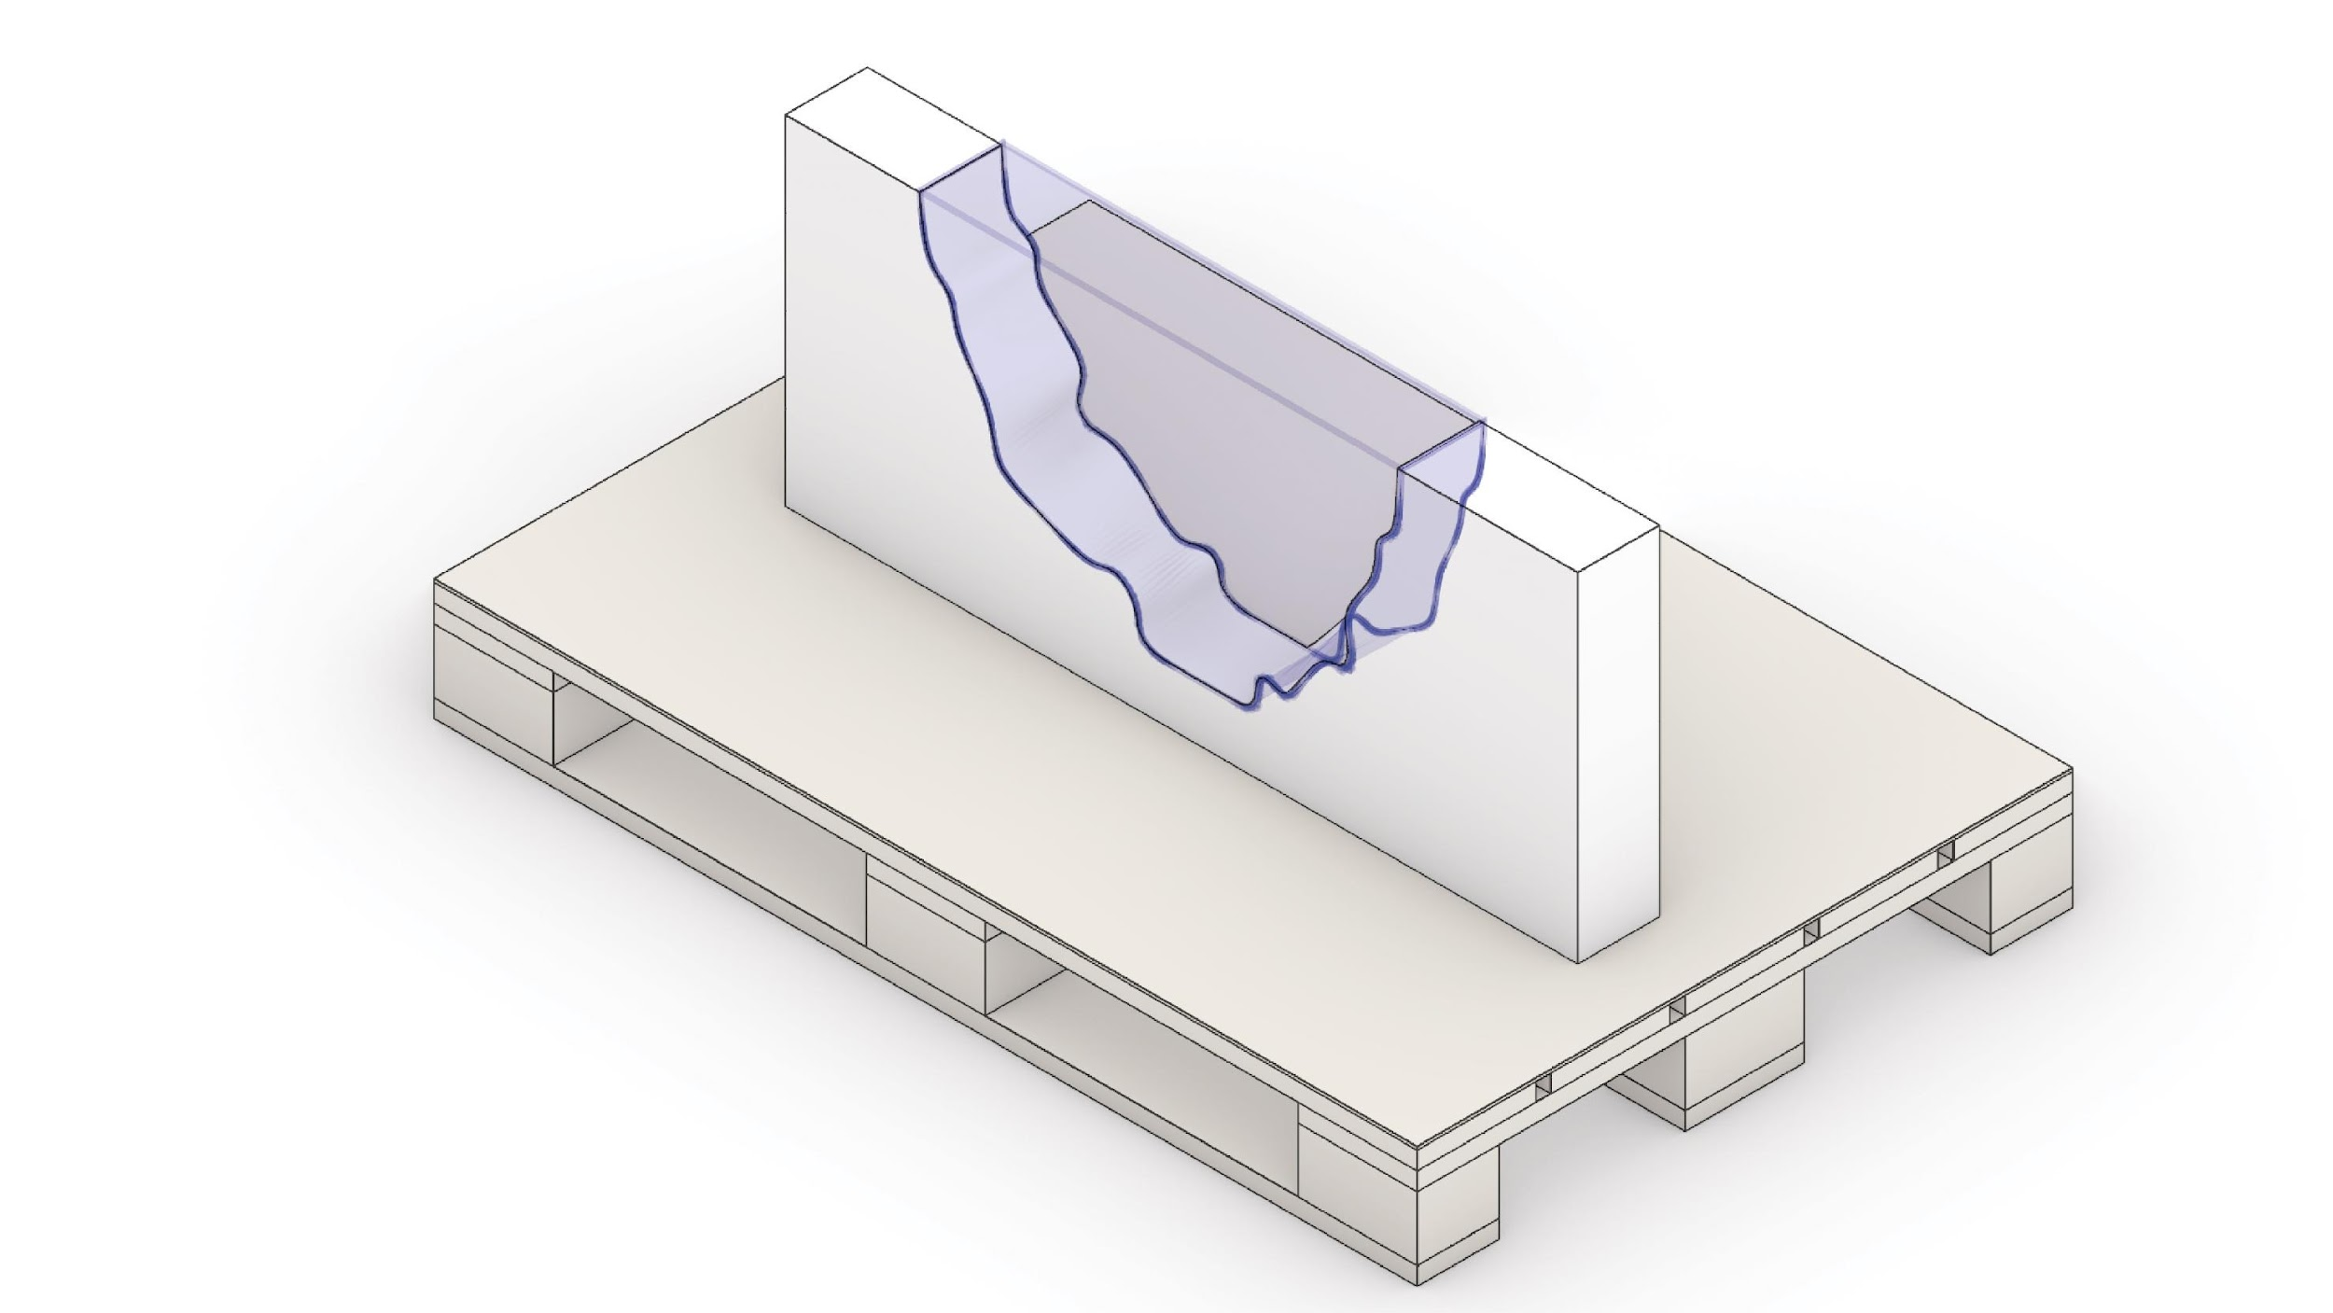
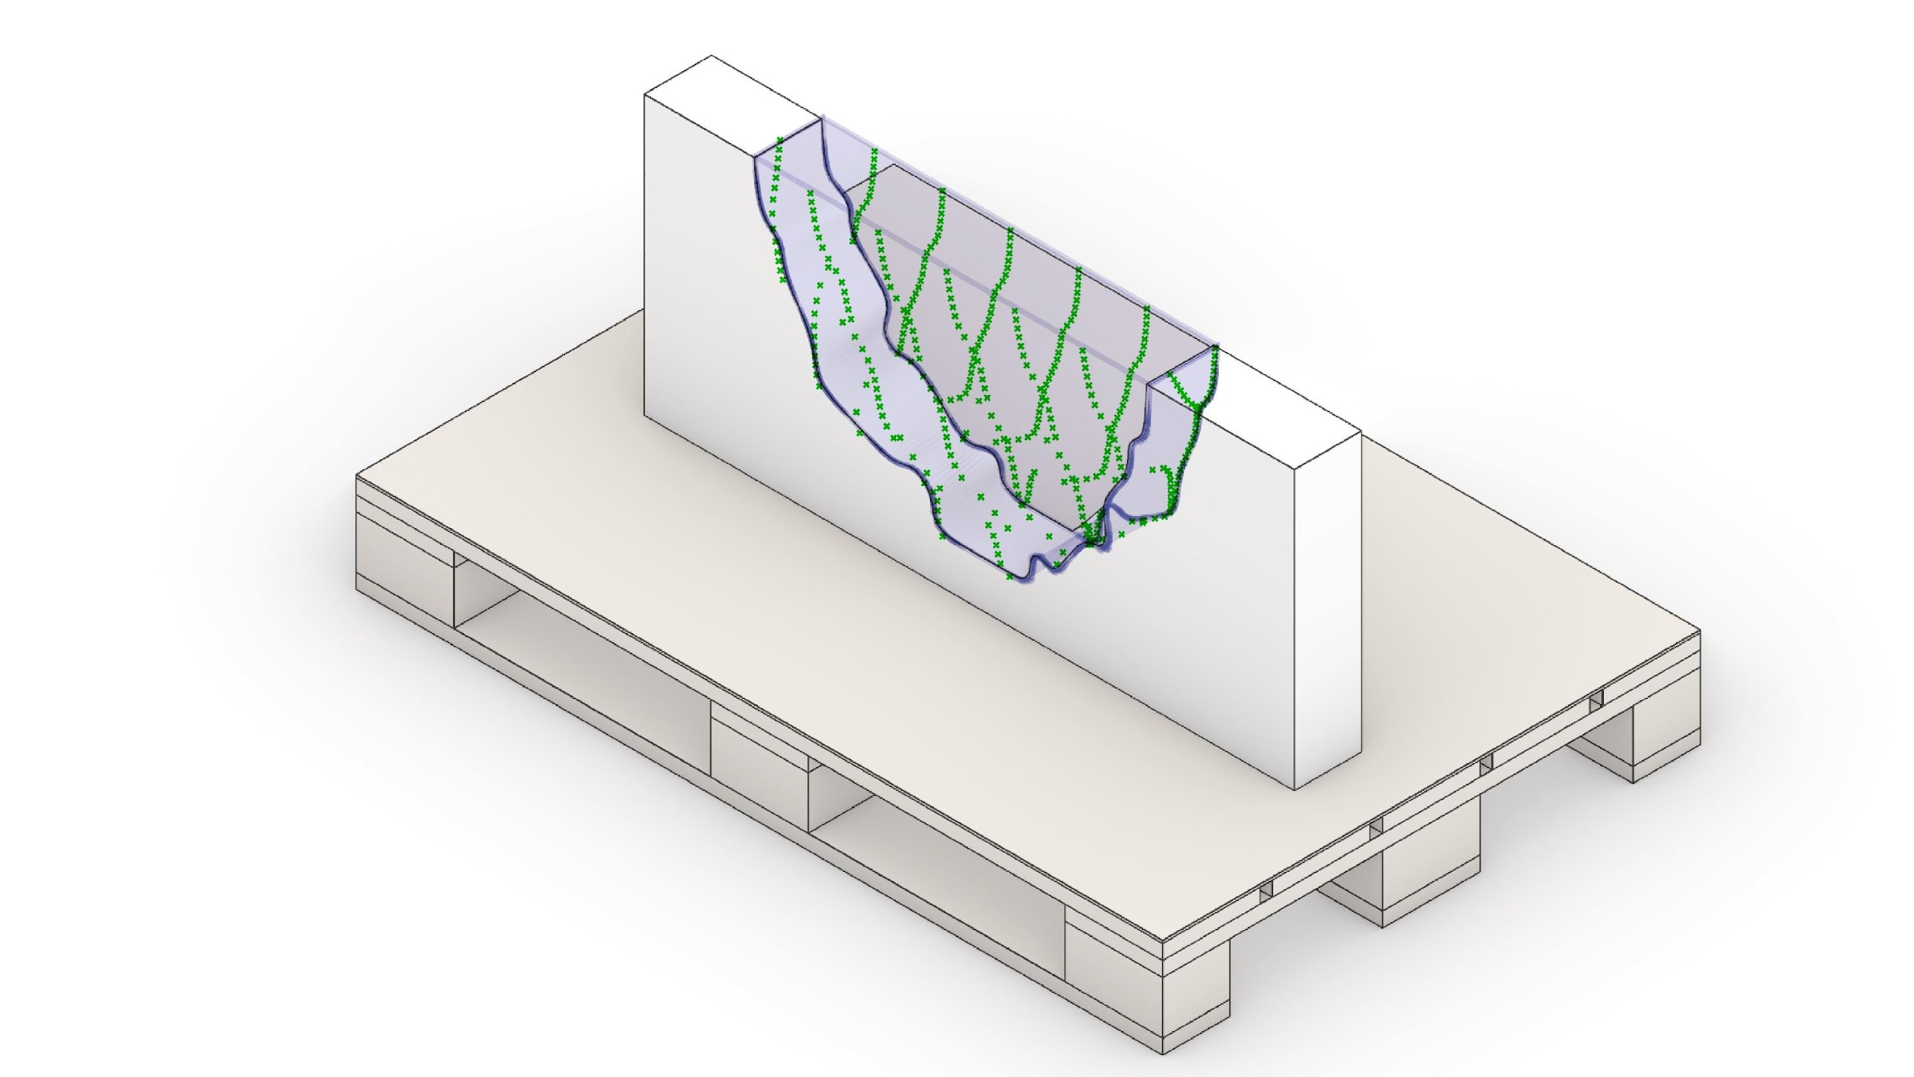
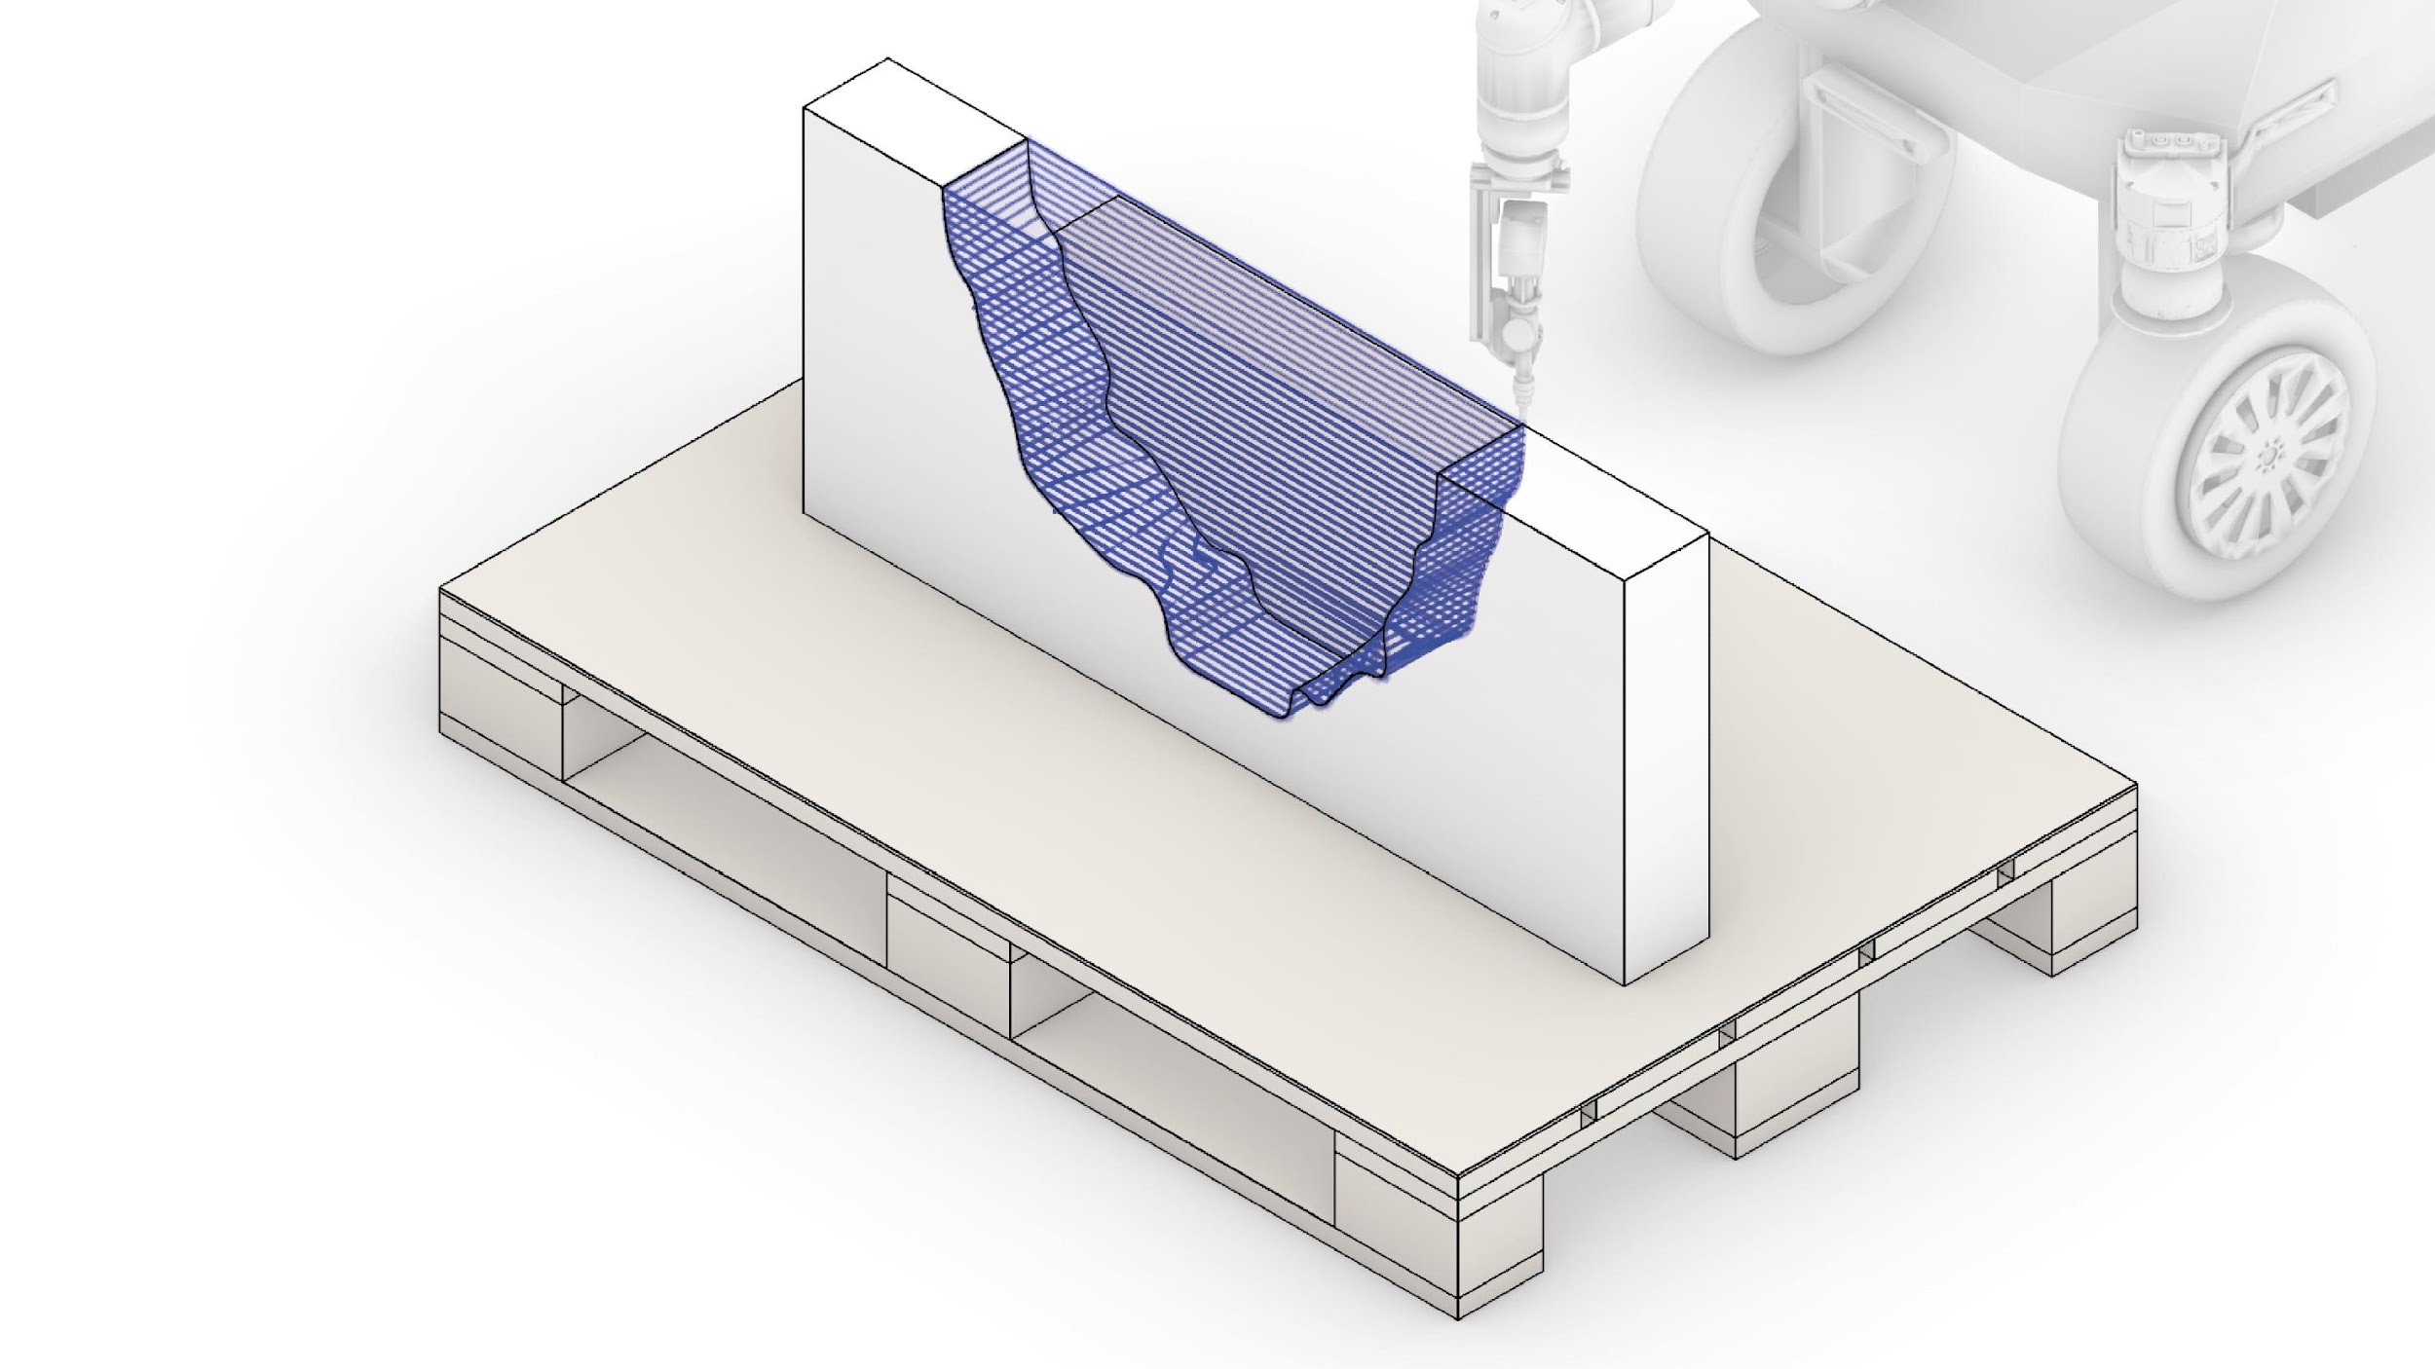
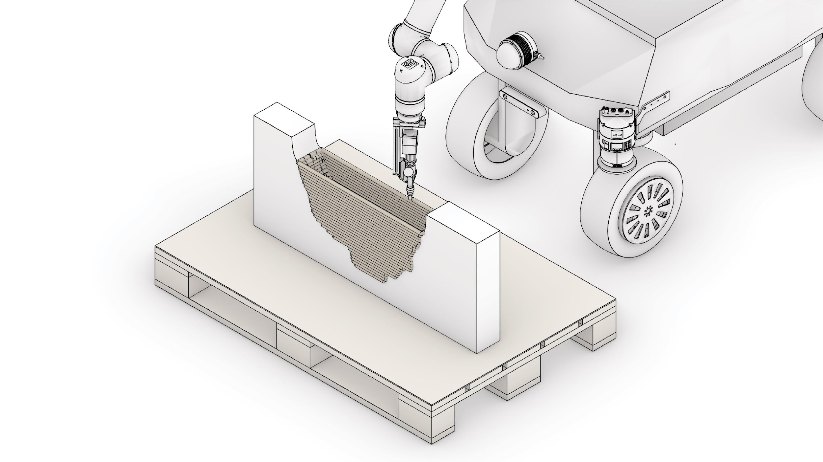
Workflow
1
3D Object to be revAMped
2
Driving the mobile-robot
3
Real Sense Positioning
4
Scanning Trajectory
5
Point Cloud Collection
6
Surface Re-construction
7
Printing Region Identifying
8
Printing Path Design Generation
9
Path Print Simulation
10
Extrusion 3D Printing
revAMp Fabrication Method

Slide 19


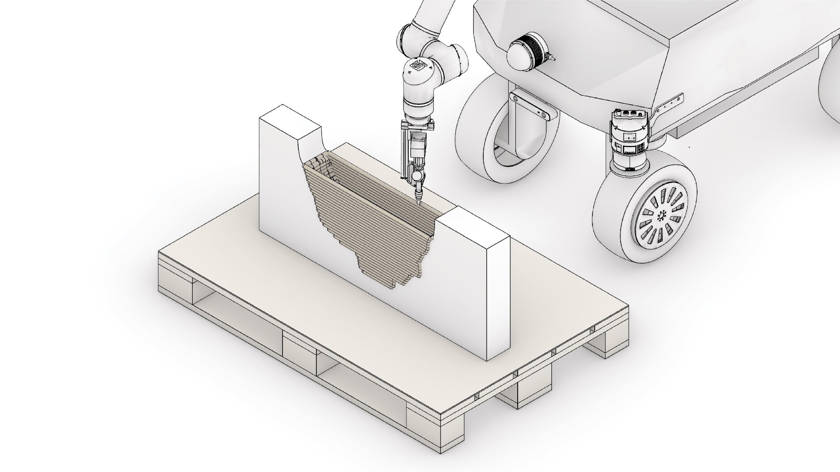
Workflow
1
3D Object to be revAMped
2
Driving the mobile-robot
3
Real Sense Positioning
4
Scanning Trajectory
5
Point Cloud Collection
6
Surface Re-construction
7
Printing Region Identifying
8
Printing Path Design Generation
9
Path Print Simulation
10
Extrusion 3D Printing
revAMp Fabrication Method

Slide 20
Workflow
3D Object to be revAMped

Slide 21
Workflow
1
3D Object to be revAMped
2
Driving the mobile-robot
3
Real Sense Positioning
4
Scanning Trajectory
5
Point Cloud Collection
6
Surface Re-construction
7
Printing Region Identifying
8
Printing Path Design Generation
9
Path Print Simulation
10
Extrusion 3D Printing
revAMp Fabrication Method

Slide 22
Workflow
Driving the mobile-robot

Slide 23
Workflow
1
3D Object to be revAMped
2
Driving the mobile-robot
3
Real Sense Positioning
4
Scanning Trajectory
5
Point Cloud Collection
6
Surface Re-construction
7
Printing Region Identifying
8
Printing Path Design Generation
9
Path Print Simulation
10
Extrusion 3D Printing
revAMp Fabrication Method

Slide 24
Workflow
Real Sense Positioning

Slide 25
Workflow
1
3D Object to be revAMped
2
Driving the mobile-robot
3
Real Sense Positioning
4
Scanning Trajectory
5
Point Cloud Collection
6
Surface Re-construction
7
Printing Region Identifying
8
Printing Path Design Generation
9
Path Print Simulation
10
Extrusion 3D Printing
revAMp Fabrication Method

Slide 26
Workflow
Scanning Trajectory

Slide 27
Workflow
1
3D Object to be revAMped
2
Driving the mobile-robot
3
Real Sense Positioning
4
Scanning Trajectory
5
Point Cloud Collection
6
Surface Re-construction
7
Printing Region Identifying
8
Printing Path Design Generation
9
Path Print Simulation
10
Extrusion 3D Printing
revAMp Fabrication Method

Slide 28
Workflow
Point Cloud Collection

Slide 29
Workflow
1
3D Object to be revAMped
2
Driving the mobile-robot
3
Real Sense Positioning
4
Scanning Trajectory
5
Point Cloud Collection
6
Surface Re-construction
7
Printing Region Identifying
8
Printing Path Design Generation
9
Path Print Simulation
10
Extrusion 3D Printing
revAMp Fabrication Method

Slide 30
Workflow
Surface Re-construction

Slide 31
Workflow
1
3D Object to be revAMped
2
Driving the mobile-robot
3
Real Sense Positioning
4
Scanning Trajectory
5
Point Cloud Collection
6
Surface Re-construction
7
Printing Region Identifying
8
Printing Path Design Generation
9
Path Print Simulation
10
Extrusion 3D Printing
revAMp Fabrication Method

Slide 32
Workflow
Printing Region Identifying

Slide 33
Workflow
1
3D Object to be revAMped
2
Driving the mobile-robot
3
Real Sense Positioning
4
Scanning Trajectory
5
Point Cloud Collection
6
Surface Re-construction
7
Printing Region Identifying
8
Printing Path Design Generation
9
Path Print Simulation
10
Extrusion 3D Printing
revAMp Fabrication Method

Slide 34
Workflow
Printing Path Design Generation

Slide 35
Workflow
1
3D Object to be revAMped
2
Driving the mobile-robot
3
Real Sense Positioning
4
Scanning Trajectory
5
Point Cloud Collection
6
Surface Re-construction
7
Printing Region Identifying
8
Printing Path Design Generation
9
Path Print Simulation
10
Extrusion 3D Printing
revAMp Fabrication Method

Slide 36
Workflow
Path Print Simulation

Slide 37
Workflow
1
3D Object to be revAMped
2
Driving the mobile-robot
3
Real Sense Positioning
4
Scanning Trajectory
5
Point Cloud Collection
6
Surface Re-construction
7
Printing Region Identifying
8
Printing Path Design Generation
9
Path Print Simulation
10
Extrusion 3D Printing
revAMp Fabrication Method

Slide 38
Workflow
Extrusion 3D Printing

Slide 39
Inspiration

Slide 40
Inspiration

